Slide 1
October 27th, 2022 | Tovah Goodman | Consulting Manager | Neon One

Slide 2
Agenda
Introduction & Housekeeping
Chat - use this for ?’s & sharing ideas
GivingTuesday prequresites
Neon One GivingTuesday Toolkit
Strategy
Follow Up

Slide 3
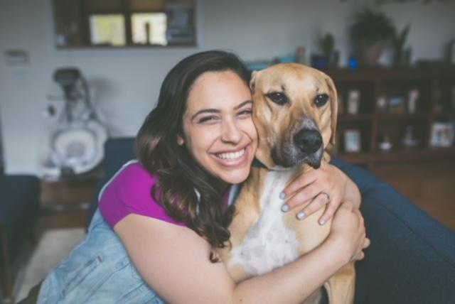
Neon One
Tovah Goodman
Consulting Manager
N1 since Sales -> Professional Services
Youth Programming NPOs
Animal Rescue and Accessibility Advocate
Musician, mom and sweater enthusiast
Notes:
Introduce yourself!
Provide professional background mixed with some more personal info - make it fun!
Do you have a picture of yourself volunteering? Bonus points if it’s with a current N1 client.

Slide 4
Housekeeping
1
This is being recorded. Our webinars are all recorded for future reference and placed into our Resources section of the Neon One website with slides and transcript.
We will be taking questions. We want this to be an actionable resource for your organization, so please use the Q&A! We will address them either in our agenda or at the end of the presentation.
2
3
We have tons of resources for you. In the deck (which you will receive a copy of!), and in the follow-up thank you email you will receive on Friday, October 28th.
Notes:
Reviewing with Marketing

Slide 5
Before you get into Neon CRM
Complete your planning sheets
Identify your target audiences
Plan your GivingTuesday branding
Solidify your communication schedule- including email and social messaging
Notes:
CHAT Poll

Slide 6
GivingTuesday Demo

Slide 7
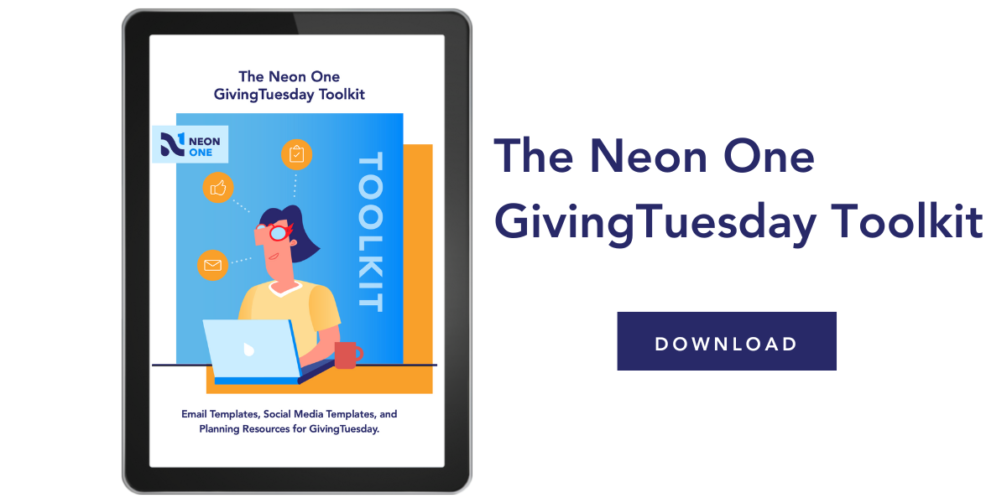

Slide 8
Questions?

